Slide 1

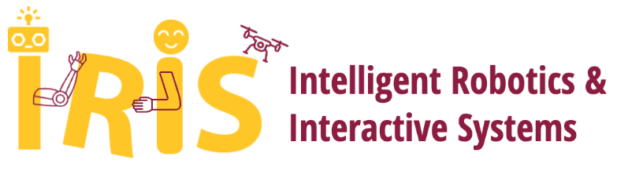
Welcome to MAE 547
Modeling and Control of Robots
Wanxin Jin
Mechanical and Aerospace Engineering
Fall 2023

Slide 2




Who am I?
Wanxin Jin, Ph.D.
Assistant Professor
Mechanical and Aerospace Engineering
Personal website: https://wanxinjin.github.io/
2010-2016
2016-2017
2017-2021
2021-2023

Slide 3
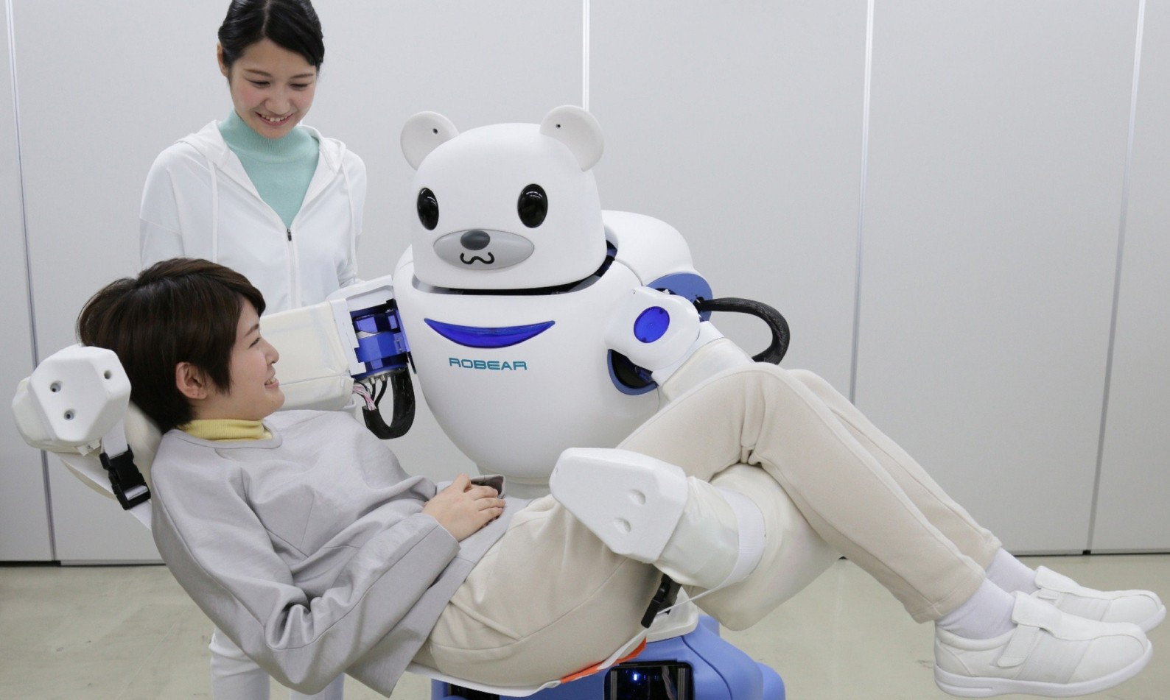
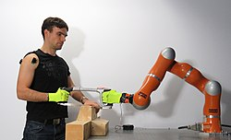
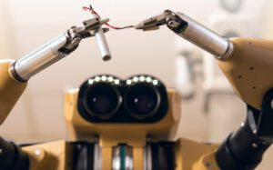
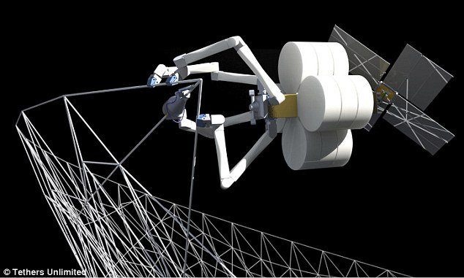
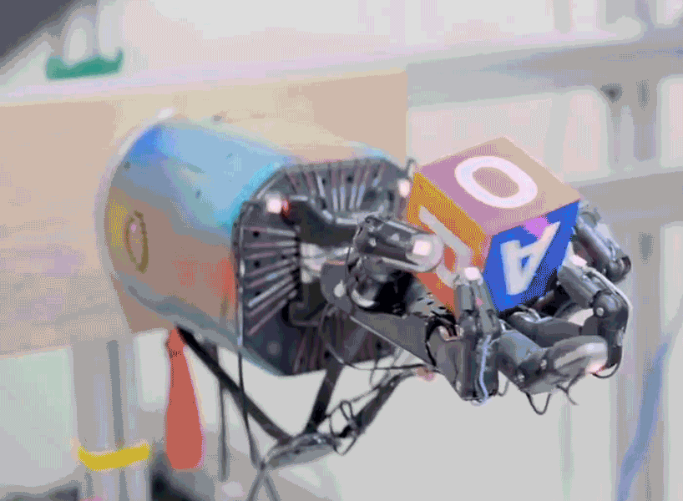
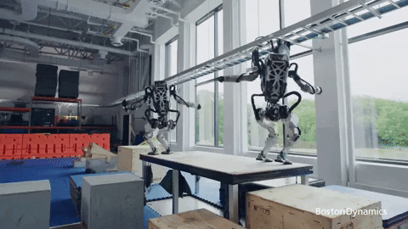
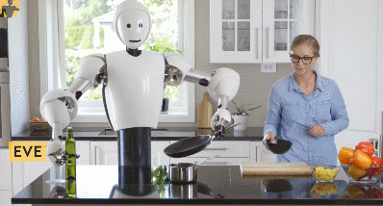
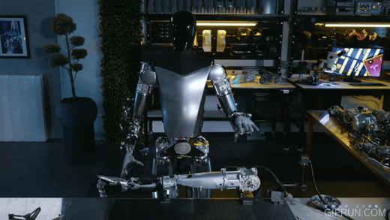
What am I doing? & What are the trends?
Make robots more capable of interacting with humans and objects/environments
bbc.com
IIT.IT
sri.com
space.com
Current trends in robot research/development
Open AI
Boston Dynamics
Halodi robotics
Tesla
Opportunities:
Google robotics, Amazon robotics, Microsoft robotics, Tesla robotics, Boston Dynamics, Nvidia robotics, Toyota Research Institute …
Notes:
Healthcare
Aging population
Labor shortage
Agile manufacturing
Logistics
Space exploration

Slide 4
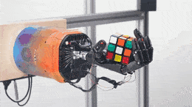
A roboticist needs to be theoretical & practical
Robot modeling
Robot control
Optimization
Machine learning
Perception (CV)
Open AI
Boston Dynamics
Python
C++
Physics simulators
Hardware programming
Halodi robotics
Tesla
Notes:
Healthcare
Aging population
Labor shortage
Agile manufacturing
Logistics
Space exploration

Slide 5
What will this course cover?
Robots! Particularly, manipulators!
List of topics:
Translation and rotation in 2D and 3D
Forward and inverse kinematics for manipulators
Velocity kinematics
Dynamics
Motion & trajectory planning
Robot control
We will use Python/MATLAB to implement computation/simulation.
Notes:
Healthcare
Aging population
Labor shortage
Agile manufacturing
Logistics
Space exploration

Slide 6
TAs & Office hours
Office Hour:
TA: Tuesday & Thursday 2:00-3:00 PM @ TBD
Me: Wednesday 2:30 - 3:30 pm or by email appointment @ GWC 464 (temporary)
Our teaching assistant:
Mukesh Ghimire
Email: mghimire@asu.edu
Our grader:
Divya Prakash
Email: divyaprakas@gmail.com

Slide 7
Course textbooks/notes & logistics
See details in the syllabus: https://www.overleaf.com/read/zrxmggrfmhvn

Slide 8
What is a robot ?
A machine— especially one programmable by a computer — capable of carrying out a complex series of actions automatically [Wikipedia]
A reprogrammable, multifunctional manipulator designed to move material, parts, tools or specialized devices through variable programmed motions for the performance of a variety of tasks [Robotics Industries Association]
An autonomous machine capable of sensing its environment, carrying out computations to make decisions, and performing actions in the real world [https://robots.ieee.org/learn/]

Slide 9
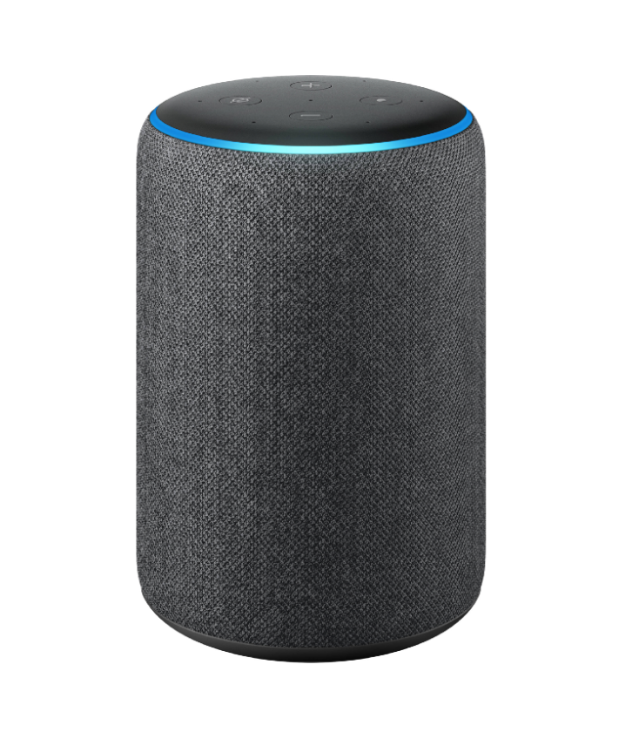
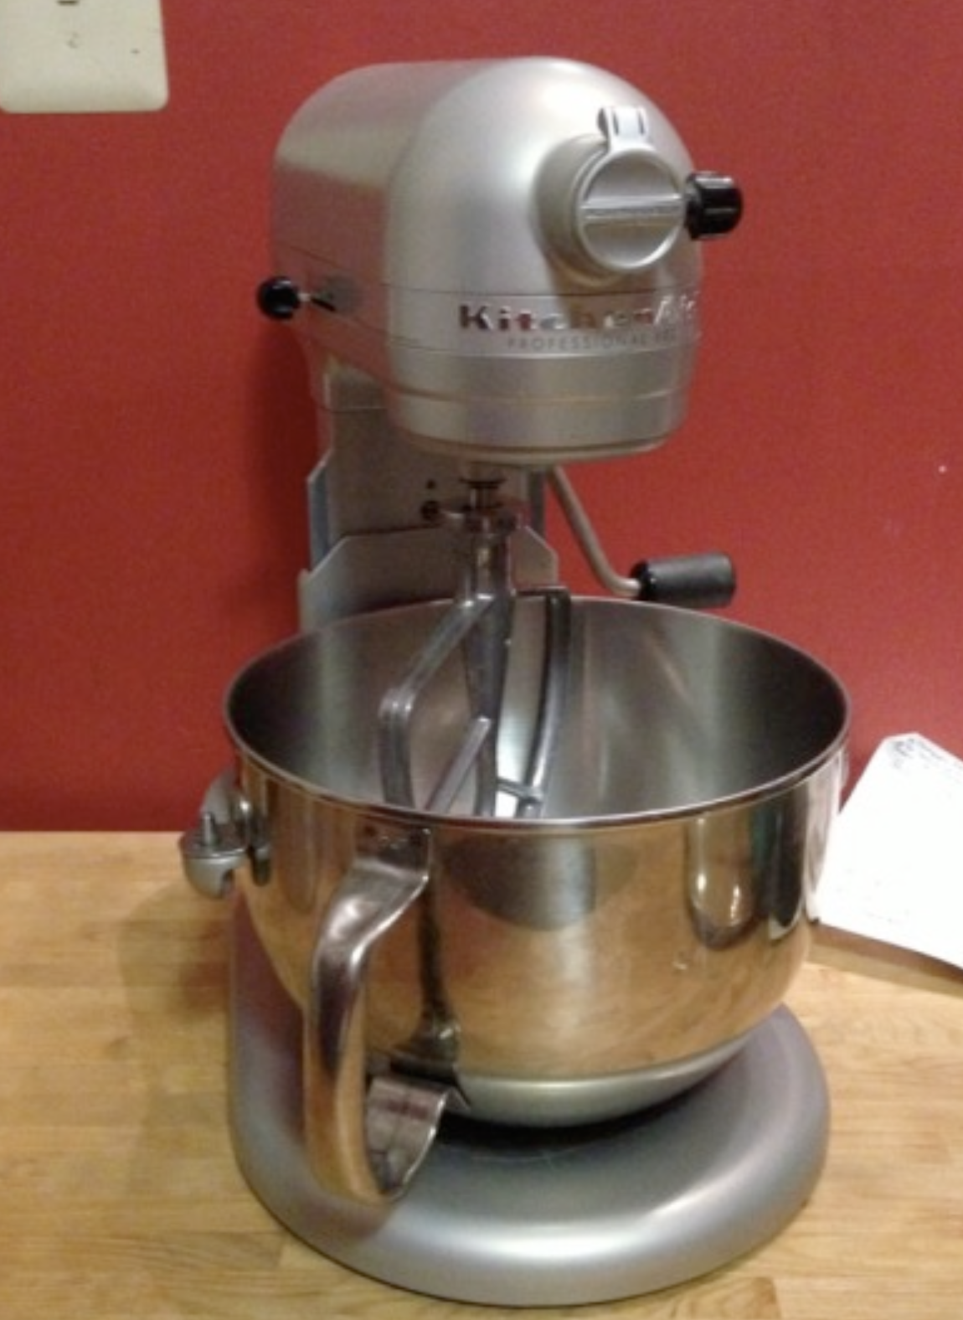
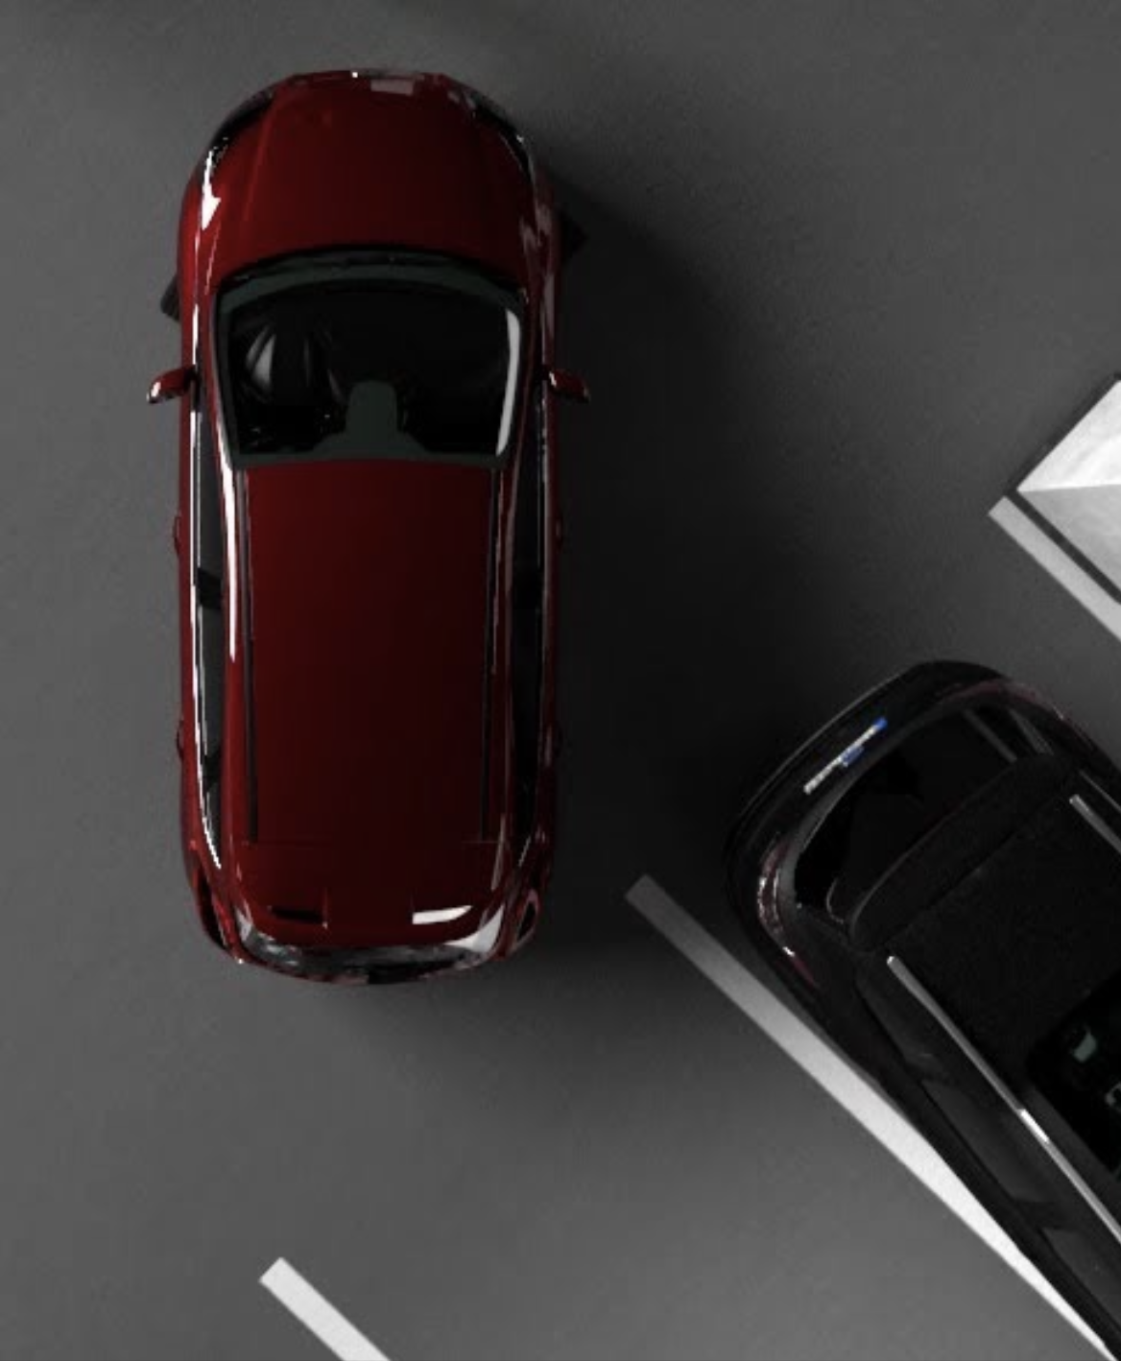
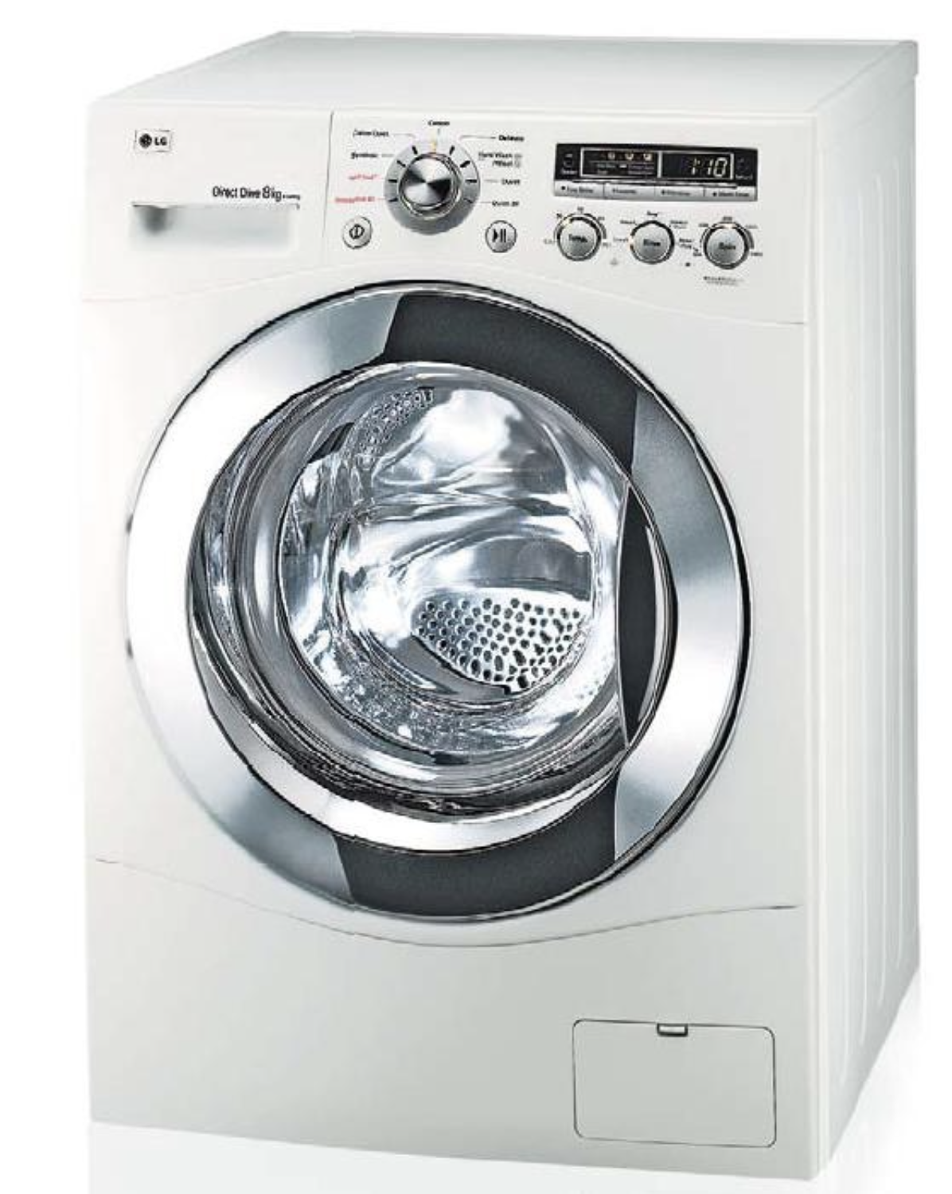
Are those robots?
This is a discussion article: https://www.wired.com/story/what-is-a-robot/
Lack of universally acceptable definition means that there could be certain level of roboticity: physical embodiment, autonomy, complexity, programmability….

Slide 10
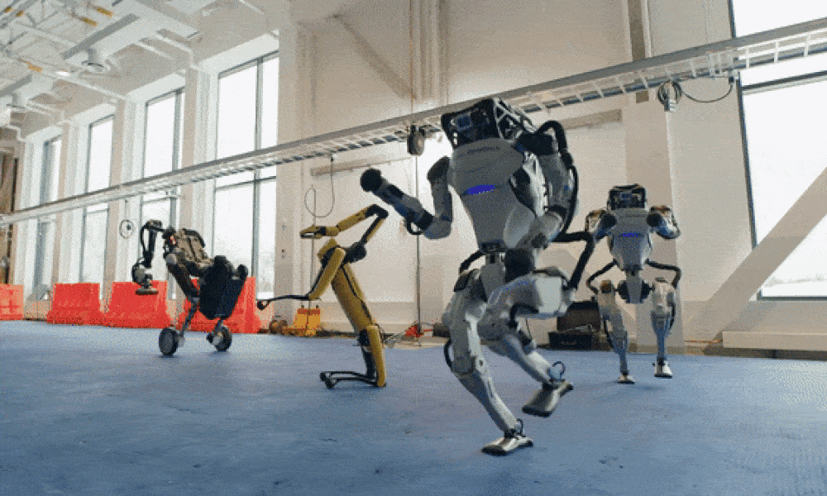
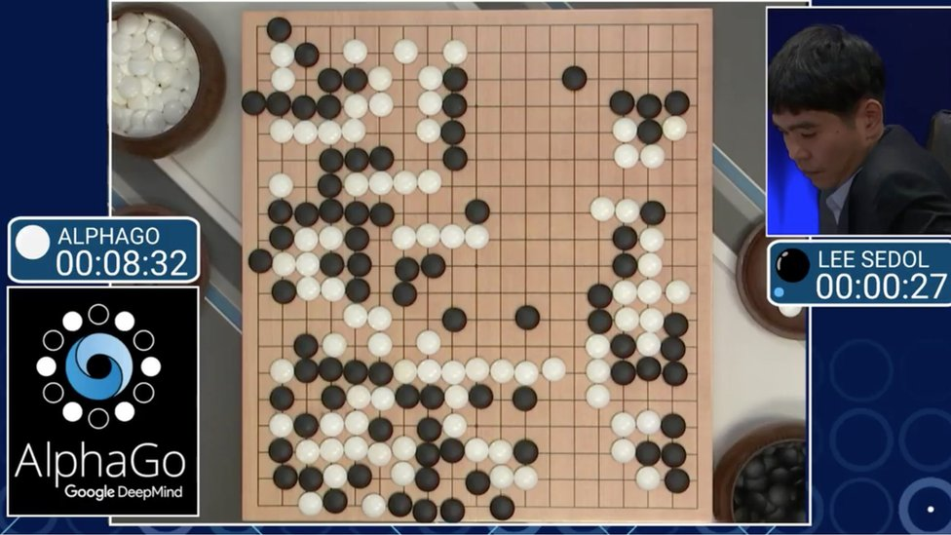
Robotics vs Artificial Intelligence
Robots are usually physically embodied
Artificial Intelligence is usually not

Slide 11
Anatomy of a robotic system
Electronic motor,
Hydraulic actuator
Actuators
Computation
Planning, Control, Learning
Sensors
Inertial Measurement Units (IMUs), Cameras, LIDAR, Encoder
Sense-Think-Act

Slide 12
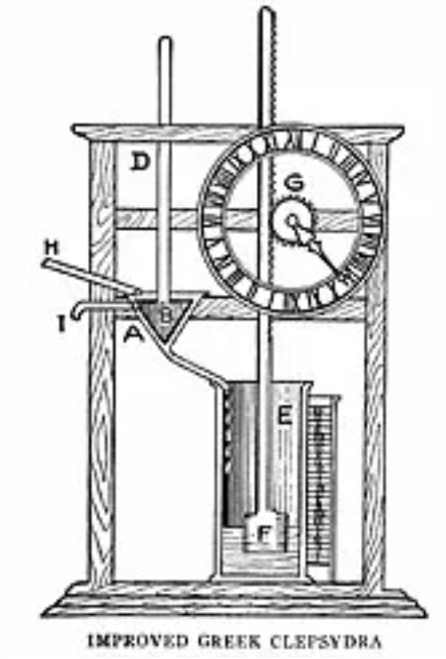
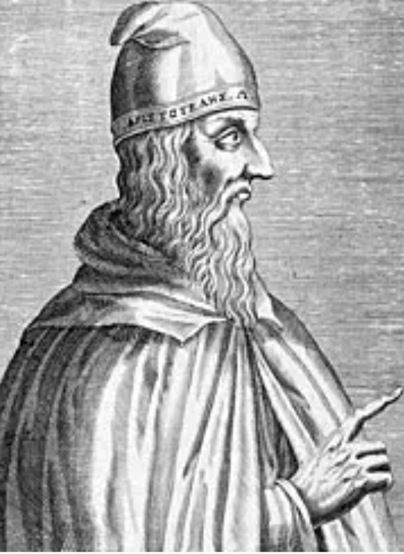
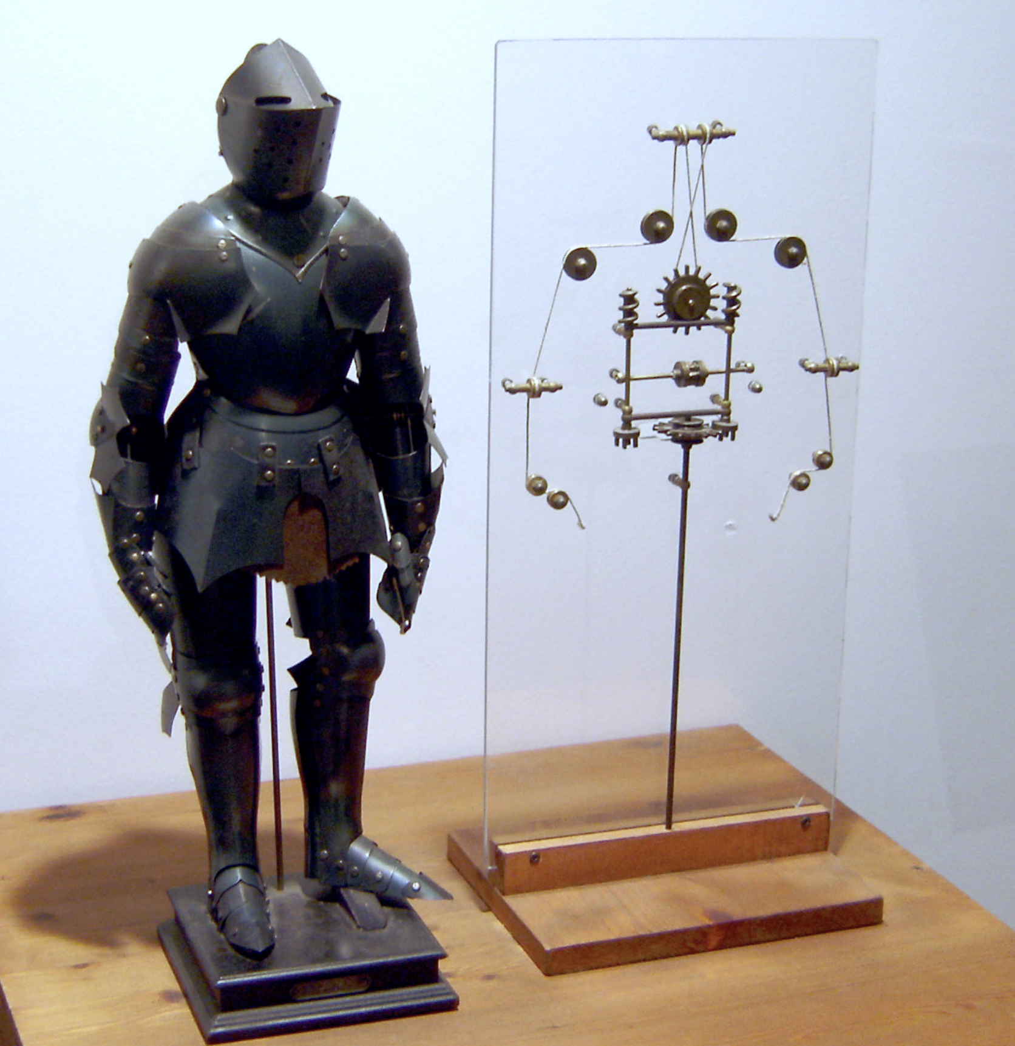
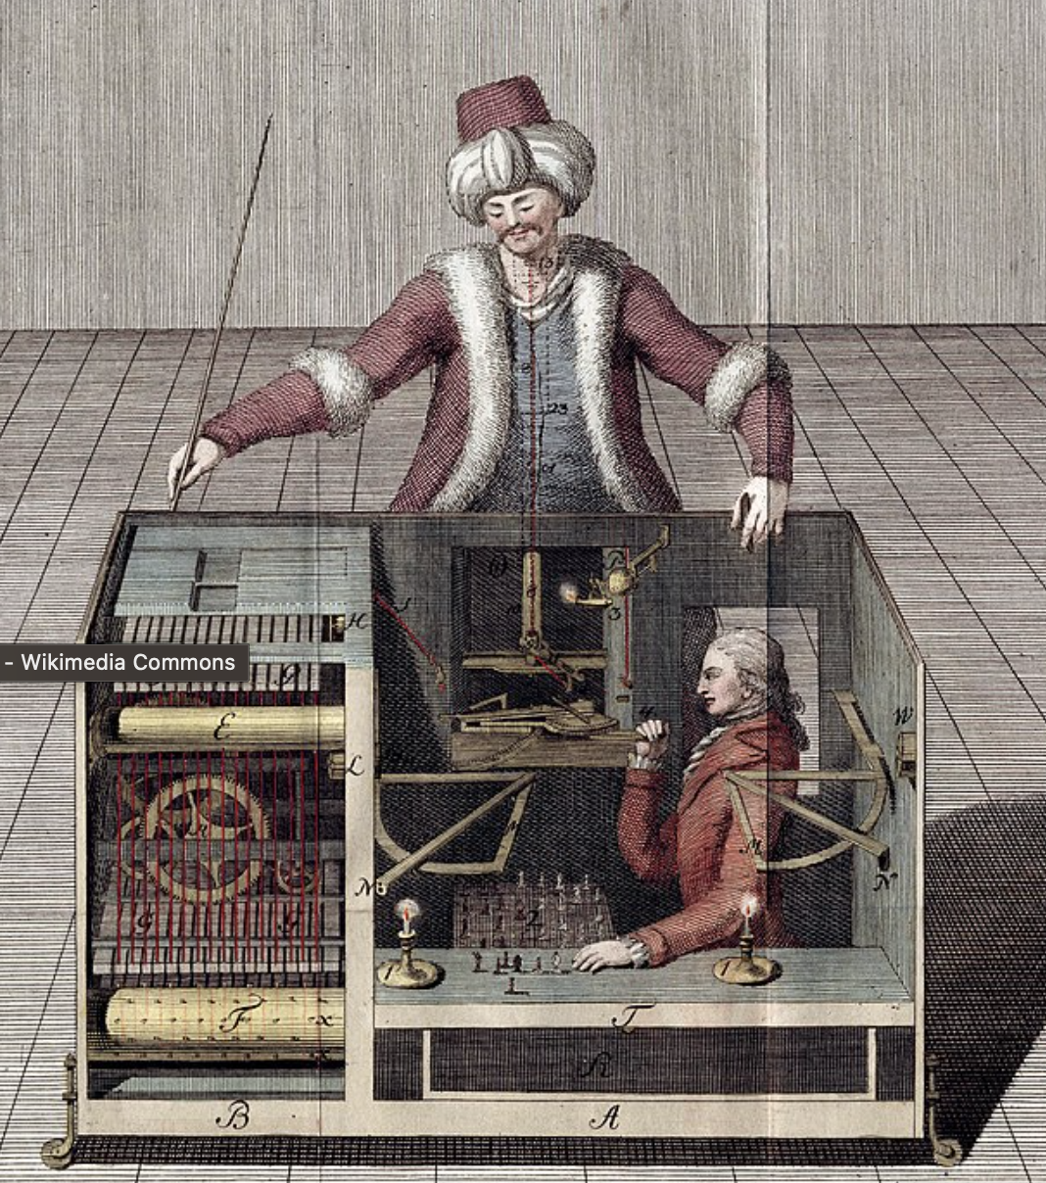
History of robotics (old)
322 BC
“If every tool, when ordered, or even of its own accord, could do the work that befits it … then there would be no need either of apprentices for the master workers or of slaves for the lords.” – Aristotle
1400 BC
“Babylonians develop the clepsydra, a clock that measures time using the flow of water. It's considered one of the first "robotic" devices in history.”
1495
“Leonardo da Vinci designs a clockwork knight that sits up, waves its arms and moves its head and jaw. The design may constitute the first humanoid robot.”
1796
"Wolfgang von Kempelen builds “The Turk,” which gains fame as an automaton capable of playing chess – until the hidden human operator was discovered!"
Notes:
Adapted from “25 Great Moments in Robotics History” on The Mr. Beng Blog

Slide 13
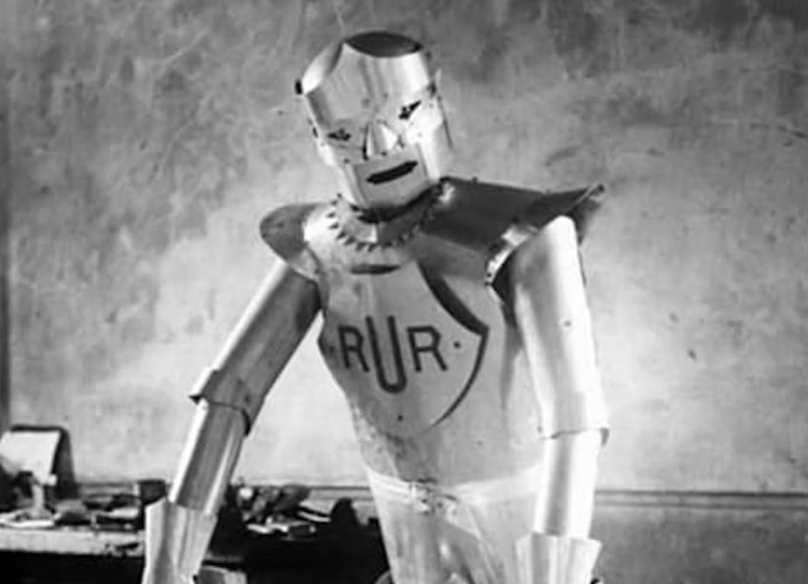
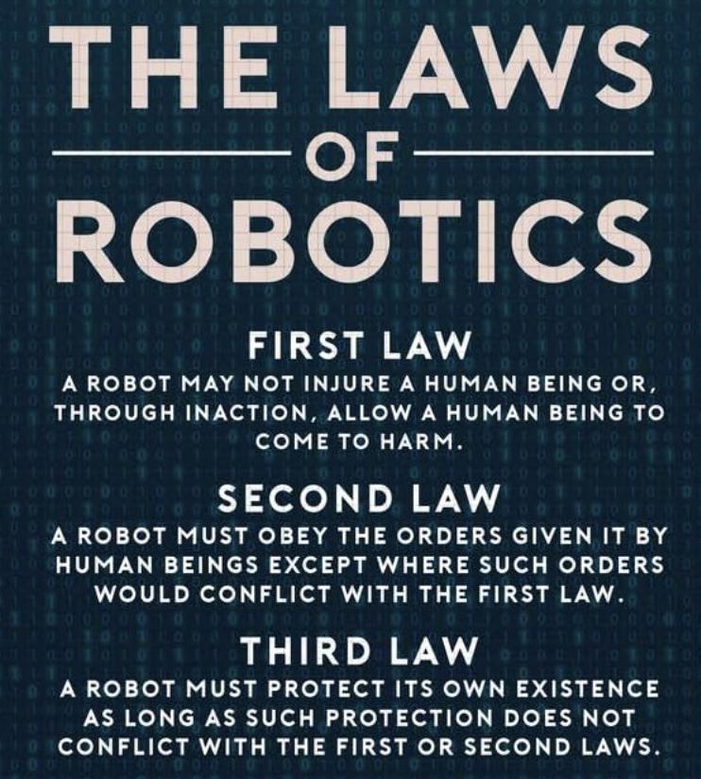
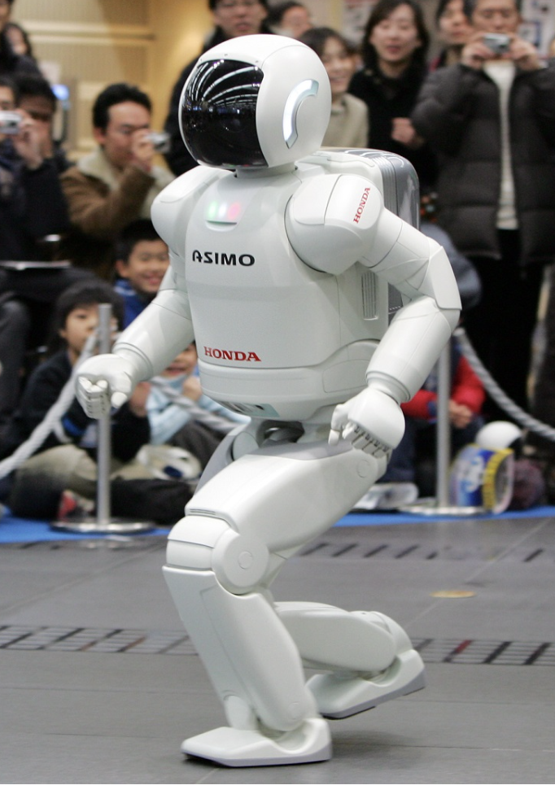
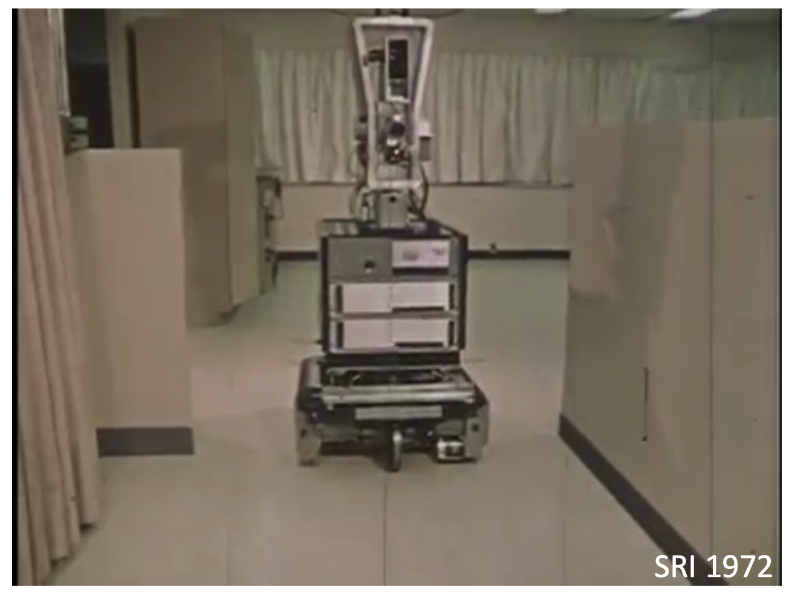
History of robotics (Modern)
1921
“Karel Capek popularizes the term ‘robot’ in a play called R.U.R. (Rossum’s Universal Robots), wherein robot workers take over the earth. ”
1942
“Sci-fi author Isaac Asimov introduced the "Three Laws of Robotics"--rules that every robot is programmed to obey.”
2000
“Honda's humanoid robot ASIMO steps onto the stage. Standing 1.3 meters tall, it can walk and run with a near-human gait.”
1966
“Stanford Research Institute makes Shakey, the first mobile robot to navigate autonomously”

Slide 14
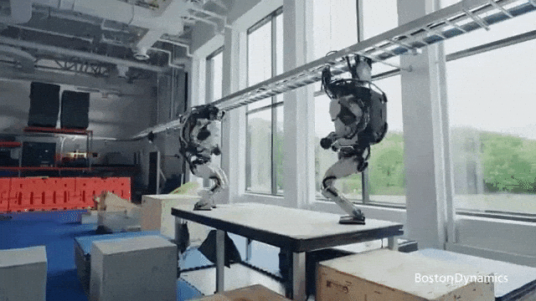
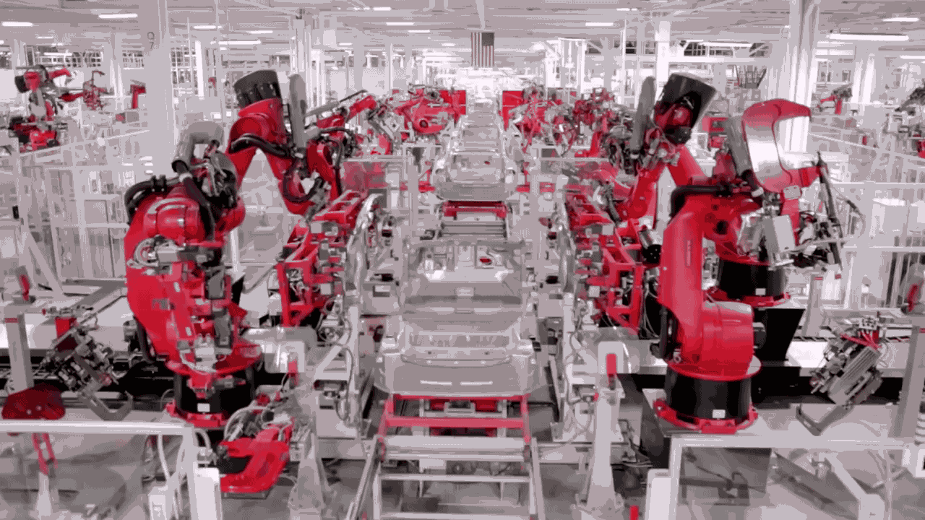
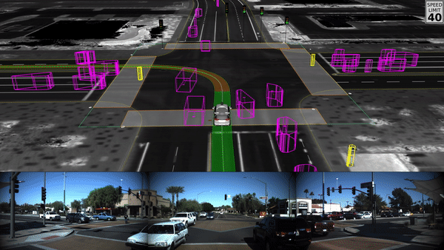
Nowadays
Manufacturing
Autonomous cars
Household assistance
Undersea exploration
Planetary exploration
Satellite retrieval/repair
Defusing explosion
Handling materials
Rescue
Military
Pack carrying
Exoskeletons
Surgery and medical
Entertainment
What are the next breakthroughs?

Slide 15
Sub-fields in Robotics (non-exclusive)
COMPUTATION & ALGORITHMS
Robot modelling & control
Optimization
Optimal control
Safety and collision avoidance
Manipulation
Robot learning
Motion planning
Navigation and mapping
Multi-robot coordination
Human-robot interaction
DESIGN
Mechanisms
Actuators
Kinematics/dynamics
Bioinspired design
Manufacturing
SENSING
Force and tactile sensing
Computer vision
Range sensing
Sensor fusion
SYTEMS/TYPES
Legged
Mobile
Aerial
Underwater
Micro/nano
Manipulators & graspers
Parallel robots
Soft robots

Slide 16
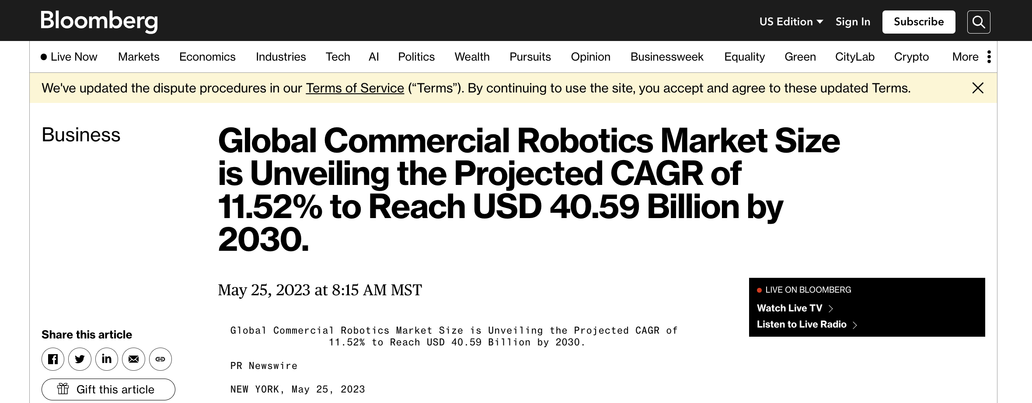
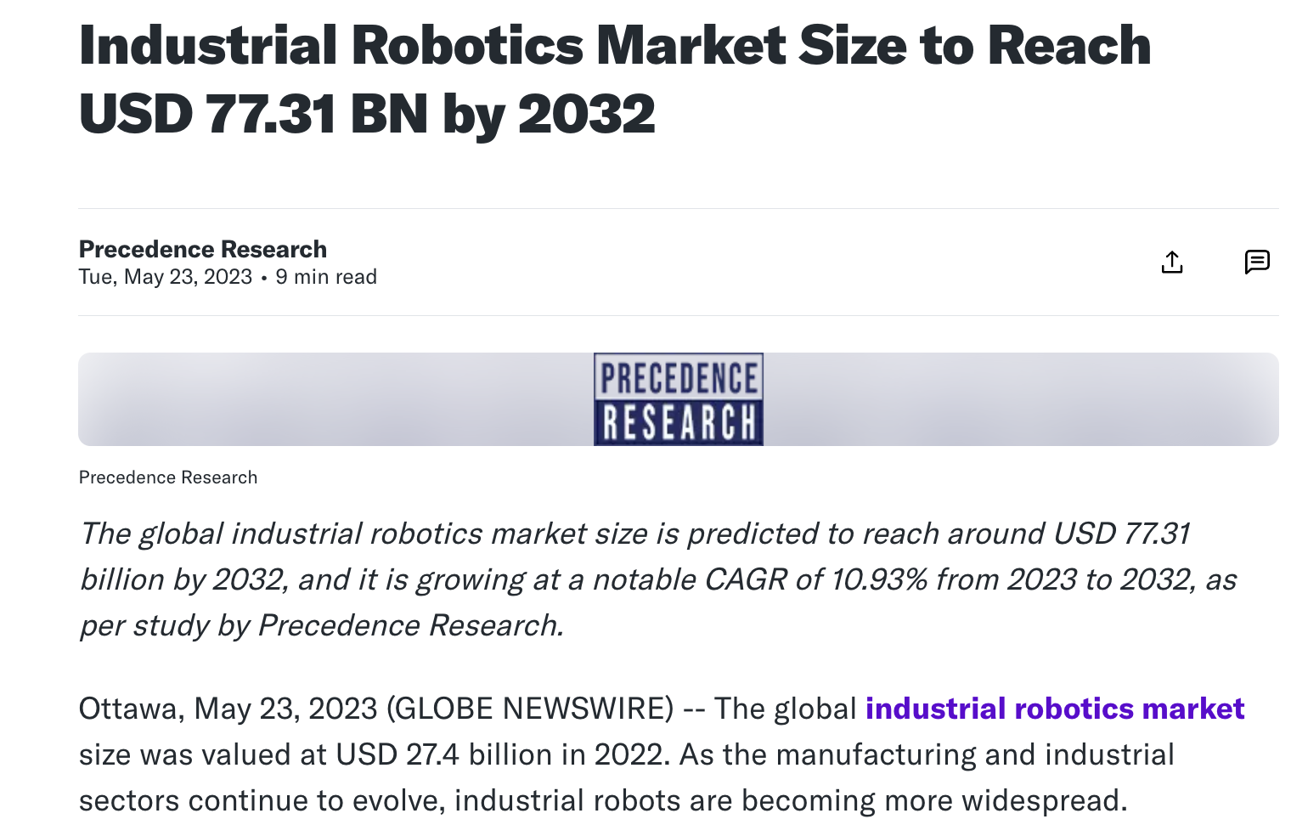
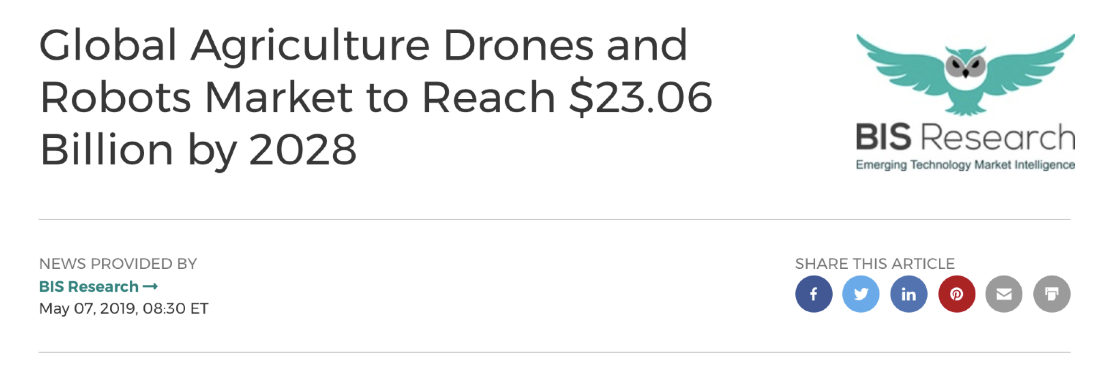
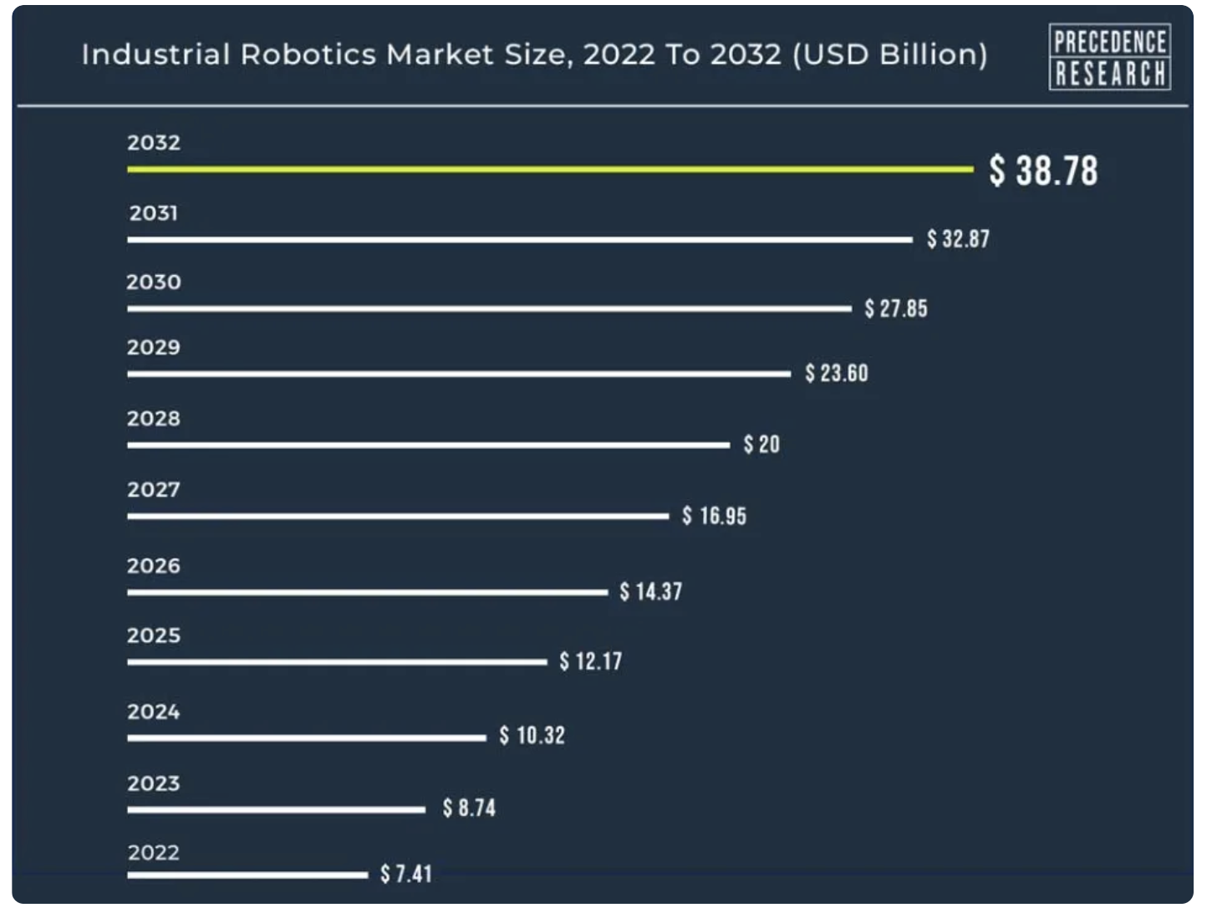
Why you need to care about robotics?

Slide 17
Why you need to care about robotics?
The global robotics market was projected to reach around $135 billion by 2025, with a CAGR of approximately 16% from 2020 to 2025.
Lots of really fascinating technical challenges (we will mention some along the class progress)
Beautiful connections with many fields: AI, machine learning, control theory, computer vision, optimization, information theory, applied math…
A field where you can ask big questions: what is physical intelligence? What us human physical intelligence?
It’s really cool.

Slide 18
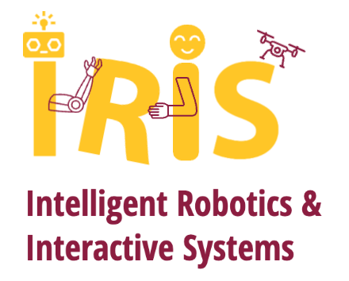
IRIS Lab is looking for “robotics enthusiasts”
IRIS: Intelligent Robotics and Interactive System
Three directions:
Robot learning with human-on-the-loop
Robot manipulation
General fundamental robotics research
How to apply:
Check research: https://asu-iris.github.io/research/
Check ``requirement”: https://asu-iris.github.io/joining/
Shoot me an email if you are interested (hopefully at end of this semester)

